Slide 1
Credit Hours and Student Success
How we came to Love the Carnegie Unit (and Mathematics)

Slide 2
Class time is formative. It enables students to gain specific insights into the world under the mentorship of experts. Every course is a vista point over a landscape that allows students to see their world differently. This is by its very nature particular -- particular to the teacher, the text, the material and the student. These insights in turn form the lenses by which students view the world. They provide understanding, cultivate the imagination and are the basis for asking new, better questions. This all takes time. Students must have more than just competencies or skills -- they must have the right kinds of intellectual experiences, whether we measure those experiences in terms of credits, tutorials, classes or some other unit.
- Johann Neem
https://www.insidehighered.com/views/2015/01/30/essay-continuing-importance-carnegie-unit-academic-credit

Slide 3
Learning takes time
How do we encourage students to take time to learn?

Slide 4
Students have a better chance to succeed:
When they understand what is expected of them
When those expectations are realistic
When they have access to the tools needed to meet those expectations
When they receive timely feedback concerning their progress on meeting expectations
When they have set aside the time to meet those expectations
When they are motivated to prioritize the work
When they show up for class, have read the material, and have completed the assignments

Slide 5
Setting Expectations of Time
Help students manage their time
Provide a clear picture of the time commitment needed to succeed
Identify estimated time needed for major components of the course
Clarify deadlines, and your policy regarding extensions, make-ups, alternate assignments, etc.
Connect the dots between assignments, readings, homework and the learning outcome - help motivate students to see the value of time spent
Let students know when feedback can be expected and how that feedback may impact upcoming work

Slide 6

How does one measure time?

Slide 7
Carnegie Units
What is the Carnegie Unit?
The unit was developed in 1906 as a measure of the amount of time a student has studied a subject.

Slide 8
In class … and outside of class
Per ICCB Administrative Rules, students should expect to spend two hours of work outside of class for every lecture hour they spend in class – regardless of the delivery method (online, hybrid, or on campus). They should expect to spend .5 hours of work outside of class for every lab hour they spend in class – that means 1 hour for every two hours in lab
Examples:
3 lecture hours – 0 lab hours- 3 credit hours = 45 hours in class + 90 hours outside of class.
2 lecture hours – 2 lab hours – 3 credit hours = 30 lecture hours and 30 lab hours + 75 hours outside of class

Slide 9
Factors that impact “time”
Page Density
Text Difficulty
Reading Purpose
Complexity of Problems
Level of comprehension, critical thinking or application of material you are seeking from the student
Student’s individual characteristics, prior experiences with similar material, grasp of foundational knowledge, motivation and commitment to learning, life

Slide 10
How fast does anyone read?
Some sources calculate an average of 1.5 hours to read a 30 page chapter in the average textbook. Cornell University recommends that students multiply the number of pages by 5 to get the expected time it will take to preview, read actively, and review textbook material.
https://www.cornellcollege.edu/academic-support-and-advising/academic-support/study-tips/reading-textbooks.shtml

Slide 11
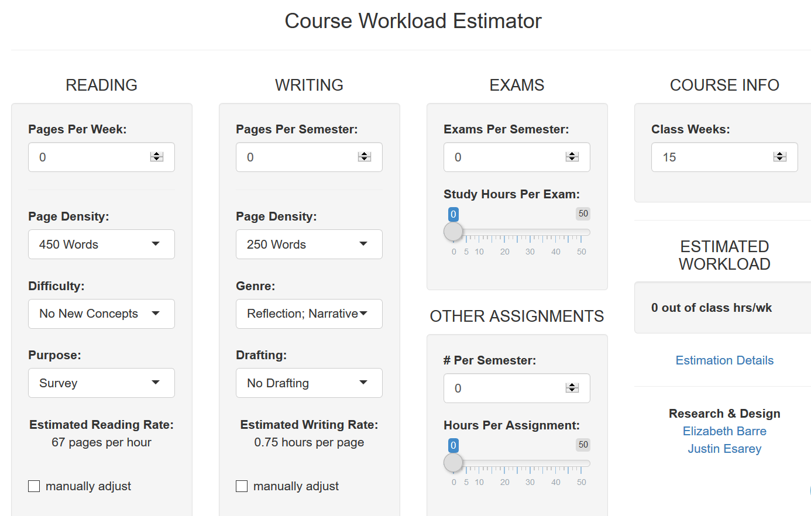
Example of Workload Estimator https://cte.rice.edu/workload

Slide 12
Lecture Courses
The following definitions will be used in determining the assignment of credit hours to a course. These definitions are based on the Federal Credit Hour definition and the ICCB System Rules, Section 1501.309.
Lecture/discussion-oriented courses: One semester credit hour is assigned for every 15 classroom contact hours per semester. For each classroom contact hour, students should invest a minimum of two hours in outside-of-classroom study and relevant learning activities (ICCB).

Slide 13
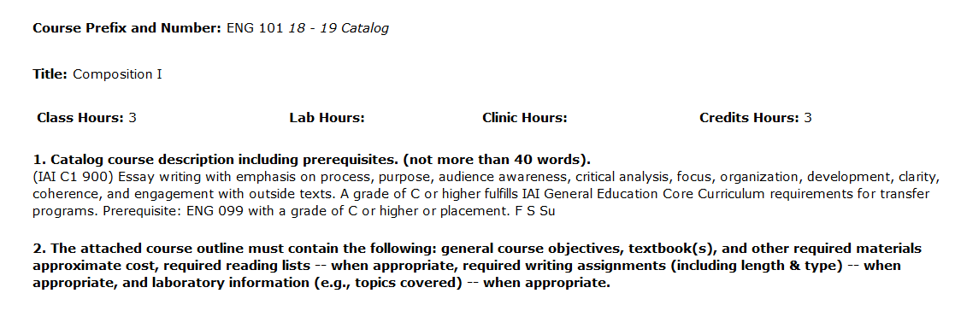
Check the CIF to Confirm Credit Hours
This is a
3-0-3 course
3 hours of lecture
With no lab
Total Credits: 3
3 lecture hour x 15 weeks = 45 hours in the classroom

Slide 14
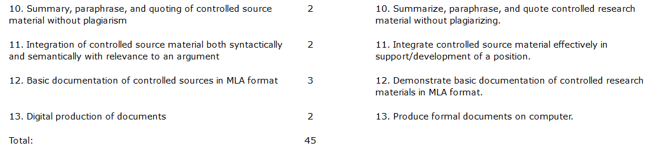
Check the CIF to Confirm Clock Hours
3 credit hours: 45 contact hours (15 hours per credit)

Slide 15
Lecture Courses continued …
Think about your course
  What are the major components students will work on outside of class time?
  Are there components such as Discussion Posts, outside quizzes, reading assignments?
  Can you help students identify those components where time is best spent?
All courses will not look alike on a template.
Mainly, HLC will want to see documentation time and effort.
Lecture Course 3-0-3
Lecture Hours | 45 hrs
Outside Work | 90 hrs
Total | 135 hrs
XXX 123 Course Activities | Expect to Spend
In class lecture | 45 hours/ 3 hours week
Reading Assignments | 30 hours/2 hours week
Homework | 15 hours/ 1 hour week
Studying/Test Prep | 45 hours/ 3 hours week
Total | 135 hours

Slide 16
Lab Courses
Laboratory courses: One semester credit hour is assigned for every 30 to 35 classroom contact hours per semester. For every two laboratory contact hours, students should invest a minimum of one hour in outside-of-classroom study and relevant learning activities (ICCB).
At Parkland College, when a course has 30-45 hours of lab time, it is one credit hour. If the course CIF is 30 contact hours, you should have one hour of outside work. If the course is 45 contact hours, then you do not have to document outside work.

Slide 17
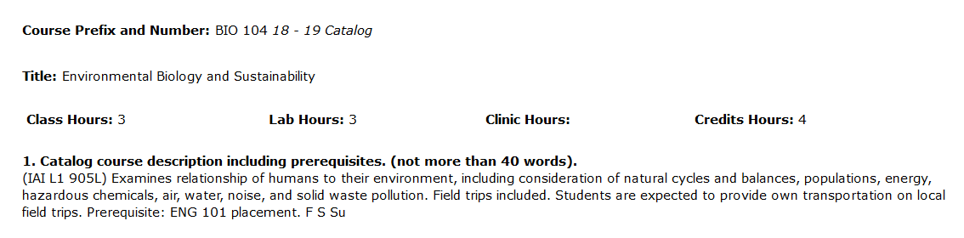
Check the CIF to Confirm Credit Hours
This is a
3-3-4 course
3 hours of lecture
3 hours of lab
Total Credits: 4
Lab Hours: 2-3 Lab hours is
one credit hour.
3 lecture credits + 1 lab credit =
4 credit hour course

Slide 18
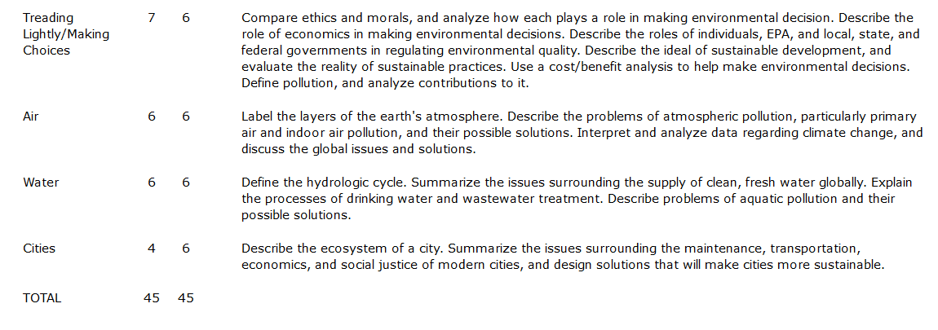
Check the CIF to Confirm Clock Hours
3 credit hours: 45 contact hours (15 hours per credit)
2 credit hour of lab is 45 hours.

Slide 19
Lab Courses Continued…
Think about your lab course
  Is it hands on for the entire lab section?
  Do you have some downtime when students work on worksheets/readings?
  Do you give homework assignments specific to lab?
All courses will not look alike on a template.
Mainly, HLC will want to see documentation time and effort.
XXX 123 Lab Course 0-3-1
Lab sessions | 45 hours/ 3 hours week
In class worksheets
Homework | No homework
Total | 55-60 hours per semester
XXX 123 Course 0-2-1
Lab sessions | 30 hours/2 hours week
In class worksheets
Homework | 15 hours/1 hour week
Total | 45 hours

Slide 20
Clinical, Internship, or Practicum Courses
Clinical Practicum courses: One semester credit hour is assigned for every 30-60 contact hours per semester. For every two practicum contact hours, students should invest a minimum of one hour in outside-of-classroom study and relevant learning activities (ICCB).
Internship Courses: Courses in which students participate in nonclinical internship, practicum, or on-the-job supervised instruction shall receive one semester credit hour or equivalent for each 75-149 contact hours, at a minimum, per semester credit hour or equivalent (ICCB).
At Parkland, the hour ratio for clinicals, internships, and practicums vary from course to course. Regardless of the ratio, there is a total number of hours listed on the CIF and students should be aware of the time they need to set aside for success in the course.

Slide 21
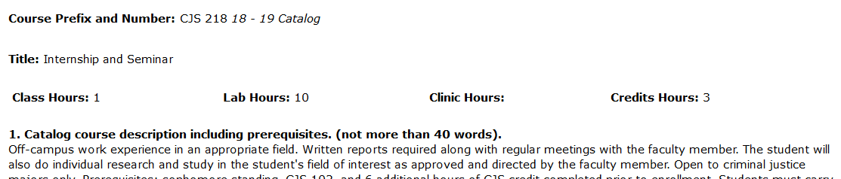
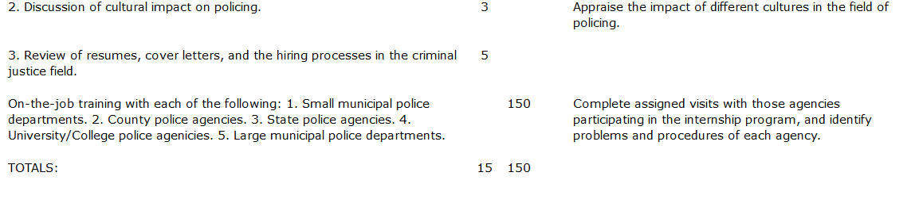

Internship Courses
XXX 123 Internship | 1-10-3
On-site | 150 hours/10 hours per week
Lecture | 15 hours/ 1 hour per week
Reading | 30 hours/ 2 hours per week
Total | 195 hours/approx. 13 hours per week

Slide 22
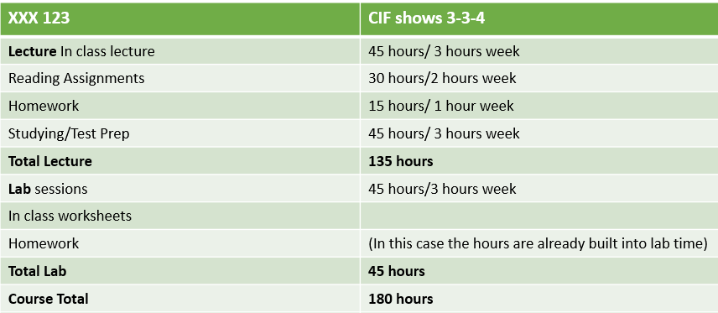
Putting Lecture and Lab Together

Slide 23
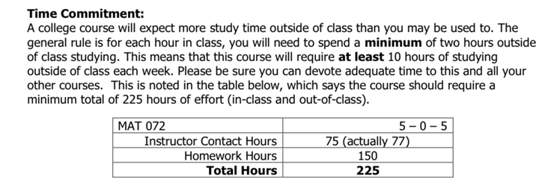
Example from Math

Slide 24
Consider length of the course ….
If you teach a course in 13-week or 8-week formats you will need to calculate time accordingly.
For example, students can expect to spend 5 - 6 hours per week working outside of class in a 16-week course.
Double that for an 8-week course.
If they take the course in a 13-week format they should expect to spend roughly 7 hours per week.

Slide 25
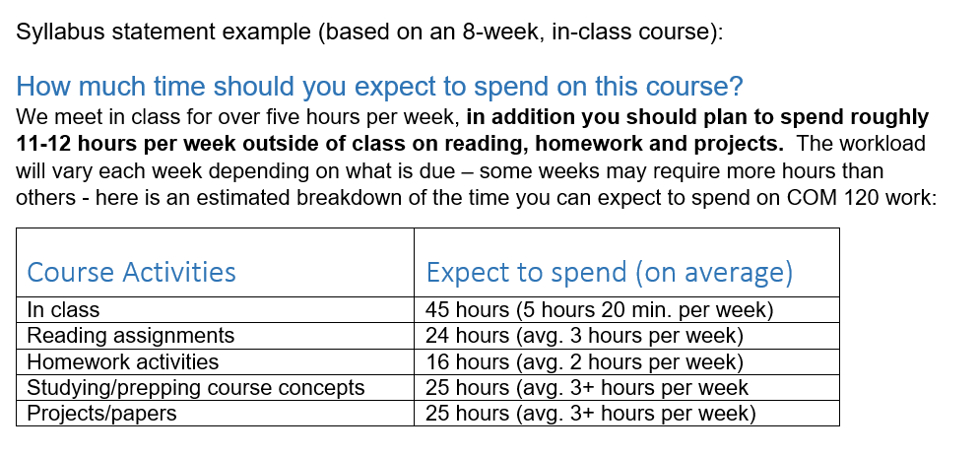
Example from Fine and Applied Arts

Slide 26
Expectations of HLC and ICCB
Assignment of Credits (HLC FDCR.A.10.020): An institution shall be able to equate its learning experiences with semester or quarter credit hours using practices common to institutions of higher education, to justify the lengths of its programs in comparison to similar programs found in accredited institutions of higher education, and to justify any program-specific tuition in terms of program costs, program length, and program objectives. Affiliated institutions shall notify the Commission of any significant changes in the relationships among credits, program length, and tuition.

Slide 27
Higher Learning Commission Visit in 2022
Parkland College will have an HLC visit in 2022.
The HLC Peer Review Team may audit randomly chosen courses to see whether there is sufficient evidence in the syllabi that the credits that we charge students matches the amount of faculty initiated instruction and learning activities.
Additionally, it is important at the start of each semester to know what to expect for the workload for the course: the amount of time for reading, studying and assignments. Students need to know how much time to set aside (Lau 2019).

Slide 28
Course Syllabi for Spring 2020
All syllabi should include a Carnegie Unit table.
If you have already printed your syllabus, please post an addendum on Cobra and direct students to the information
Consider spending just a portion of time in the first week of class to talk with your students about time management
Check in with them throughout the semester to make certain they are mindful of the expectations
When ever possible, give them a “heads-up” about assignments or sections of the course that might require more time than others – help them plan ahead

Slide 29
Remind students that these are estimates of time
Include a Syllabus Statement (above or below the table)
“The following table represents the expected course workload for this course. The times listed for readings and assignments are estimates and will vary from student to student. “

Slide 30
Let’s Review……
PLAY 101 - Philosophy of a Happy Childhood is a 1-5-3 class
1 hour in the classroom per week X 15 weeks = 15 hours
15 X 2 = 30 hours work to be expected outside class
5 hours in lab per week X 15 weeks = 75 hours
75 X .5 = 37.5 hours expected outside class
PLAY 123 Course 1-5-3
Lecture sessions | 15 hours/ 1 hour per week
General “Tom-foolery” | 9 hours/ .6 hour per week
Reading With Parents | 12 hours/ .8 hour per week
Silly Shenanigans | 9 hours/ .6 hour per week
XXX 123 Course 0-2-1
Lab sessions | 75 hours/5 hours per week
Play Doh Sculptures | 15 hours/ 1 hour per week
Testing Gravity Outdoors | 22.5 hours/1.5 hours/week
Total | 157.5 hrs/10.5 hrs/week

Slide 31
Questions?

